Slide 1
Supply - TOWER

Slide 2
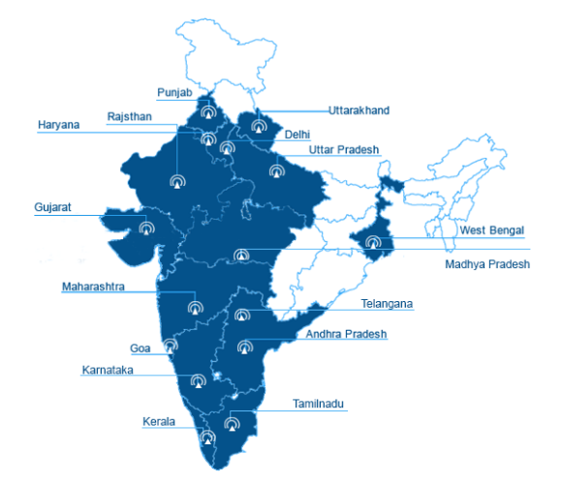
Business Overview
100+ skilled professionals & safety certified teams for Mount / Tower Installation.
Operating in 11 telecom circles.
Leaders in telecom infra activities.
OHSAS 18001, ISO 14001,ISO 9001 certified.
Catered telecom activities on 85000 sites.
It’s one of the oldest & largest structural company in the world which is operational since last 5 decades.
Huge capacity of 66K MT to manufacture and cater any kind of structural requirement.

Slide 3
Company’s Milestones
Customer | Location | Tower Type | Towers Count | Erection Count
Indus | PAN India | Supply of 40M Zeta Eco | 1175 | 515
 |  | Supply of 30M GBM | 890 | 675
 |  | Supply of Elite 403 Tower | 656 | 208
 |  | Supply of VT30M Tower | 60 | 7
 |  | Supply of 12M/15M/18M RTD | 63 | 26
Airtel | PAN India | Supply of 31M Monopole | 53 | 37
 |  | Supply of 40M Lean Tower | 16 | 6
Ascend | PAN India | Supply of 40M Hybrid Tower | 226 | 180
Rajasthan Govt | Rajasthan | Supply of 40M Tower | 340 | 320
Kalindee Rail Nirmaan | Rajasthan | Supply of Tower 30M | 32 | 30
 |  | Supply of Tower 40M | 49 | 47
UICL | Myanmar | Supply of Monopole 30M | 2 | 0
 |  | Supply of Monopole 35M | 6 | 0
Vodafone | PAN India | Supply of 3M/6M/9M Pole | 14500 | 14500
Total |  |  | 18,068 | 16,551

Slide 4
Our Services
01
01 02 03
Solar Purlins &
Structures for
rooftop & mega
watt power plants
Including
structures for
solar pumps.
Triangular self –
supporting,
Guyed, Bilby
towers.
Certified &
Experience
installation teams
in bulk across
India.

Slide 5
Our Services
01
04 05 06
Angular/Tubular/
Hybrid Mobile
Towers up to 100 meter heights
Mount, Cable
Tray & Poles
Monopoles/
Octagonal

Slide 6
Specification of Tower
Towers type | Ecolite Tower | Hybrid Low Cost Lean Tower | Zeta 40M Tower | RTD – Delta Tower | Elite 403 | Monopole Flange Type | Vertical Mast
 | Hybrid | Hybrid | Tubular | Hybrid | Tubular | GBM | Tubular
Height Of Tower (M) | 40M | 40M | 40M | 9M,12M,15M,18M,21M & 24M | 40M | 30M | 30M
Wind Speed (Kmph) | 170 | 170 | 170 | 180 | 170 | 180 | 170
Approval | Client | Client | Client | Client | Client | Client | Client
Weight (Kgs) | 4115 | 4128 | 5212 | 1023, 1902, 2171,2783, 3425, 4114 | 4804 | 8200 | 4927
Loading Capacity | 6 Antenna (4 GSM + 2 MW) & 9 RRU | 6 Antenna (4 GSM + 2 MW), 1 Omni & 9 RRU | 10 Antenna (8 GSM + 2 MW), 2 Omni & 18 RRU & 11.16 Sqmm | NA | NA | 15 Antenna (GSM + MW) & 15 Sqm | NA
Platform (No’s) | 1 | 2 | 2 | 1 | 3 | 2 | 2
Foundation Type | Template & Bolts | Template & Bolts | Client | Client | Client | Client | Client
Base & C/C distance in MM | 4200x4200 | 5000x5000 | 4500x4500 | 1600x1600 3200x3200 | 5500x5500 | 1050x1050 | 1000x1000

Slide 7
Specification of Monopoles
Monopoles Type | Monopole Flange Type (Light Weight) | Octagonal Slip Type | Polygonal Lamp Post Slip Type
Height Of Tower (Mtr) | 31M | 30M | 35M
Wind Speed (Kmph) | 170 | 180 | 195
Approval | IITB | IITB | IITB
Weight (Kgs) | 5700 | 7800 | 7370
Loading Capacity | 10 Antenna (GSM + MW) & 10 Sqm | 21 Antenna (GSM + MW) & 21.2 Sqm | 6 GSM Antenna (GSM + MW) & 9 Sqm
Platform (No’s) | 2 | 3 | 2
Foundation Type | Template & Bolts | Template & Bolts | Template & Bolts
Base & C/C distance in MM | 1050x1050 | 1520x1520 | 1200x1200

Slide 8
Specification of Poles
Pole Types | 6M Pole Supported | 9M Pole Supported | 12M Pole Supported | 3M Pole Self-Supported | 6M Pole Self-Supported | 9M Pole Self-Supported | 12M Pole Self-Supported
Supported / Self-Supported | Supported | Supported | Supported | Self-Supported | Self-Supported | Self-Supported | Self-Supported
Height Of Pole (Mtr) | 6M | 9M | 12M | 3M | 6M | 9M | 12M
Wind Speed (Kmph) | 170 | 170 | 170 | 170 | 170 | 170 | 170
Approval | IITB | IITB | IITB | IITB | IITB | IITB | IITB
Total No. of Panels | 2 | 4 | 5 | 1 | 2 | 3 | 4
Loading Capacity | 1 MW & 3 Small Cell | 1 MW & 3 Small Cell | 1 MW & 3 Small Cell | 1 MW & 3 Small Cell | 1 MW & 3 Small Cell | 1 MW & 3 Small Cell | 1 MW & 3 Small Cell
Building Height (Mtr) | 21M | 21M | 18M | 27M | 24M | 21M | 18M
Foundation Type | Template & Bolts | Template & Bolts | Template & Bolts | Template & Bolts | Template & Bolts | Template & Bolts | Template & Bolts
Base & C/C distance in MM | 1500X1500 | 2500x2500 | 2500X2500 | 195x195 | 375X375 | 375x375 | 470X470
K1 | 0.9 | 0.9 | 0.9 | 0.9 | 0.9 | 0.9 | 0.9
K3 | 1 | 1 | 1 | 1 | 1 | 1 | 1
Weight (Kg) | 200 | 322 | 375 | 65 | 207 | 367 | 629

Slide 9
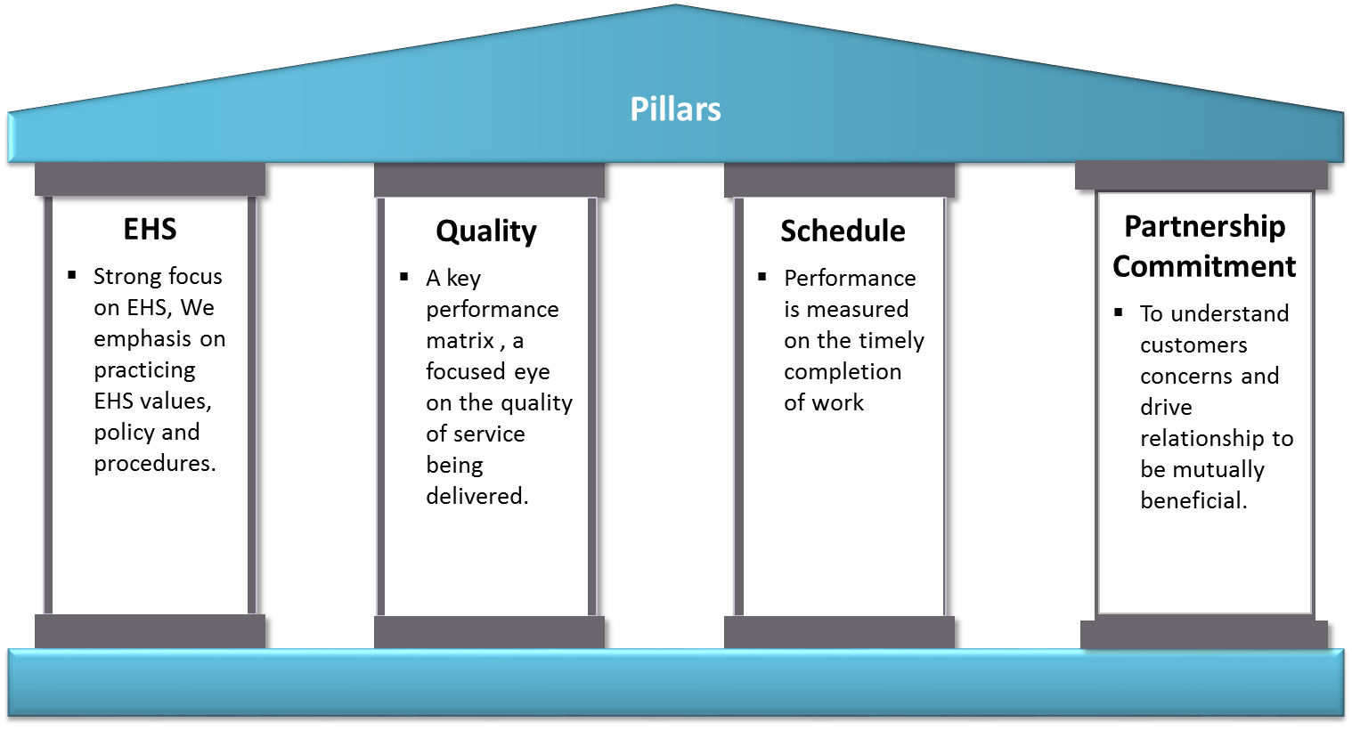
Key Matrix for Business
COSMO
End To
End
Business
Module
(S&I)
PAN
India
Presence
Speed Of
Delivery &
Quality
Cost Efficiency

Slide 10
Our Health and Safety Policy
Permits to work
Workplace Supervision
Special authorization documentation
that ensures adequate risk has been
accessed for the process.
100% available for close supervisor at site
respective to Quality, Safety management,
work Progress and site management.
Personal Protective Equipment
EHS Awareness Programs
Used as per job specification and
requirements to protect from personal
injuries.
Organised parodically as National Safety
Week, Fire Safety Week , World
Environmental Day etc.
Safety Trainings & Skill Development
Program to be conduct according to TNI
(Training Need Identifications) and task specific .

Slide 11
Our Mission, Vision & Values
Mission
To provide our customers with valued construction solutions using our
expertise in the design & installation of building components.
Vision
Be Global : A diversified, multi-national customer.
Be Fast: The quickest response in the industry.
Values
Quality
& Innovation
Continuous
Improvement
Safety
Accountability

Slide 12
Our Picture Gallery

Slide 13
140, ShriGopal Nagar, Gopalpura Bye Pass Road,
Jaipur, Rajasthan 302015
+91 141 2500801
info@cosmoinfrasolutions.com
www.cosmoinfrasolutions.com

